Slide 1




Home Credit Default Risk
Group 13 (Phase - 3)
William Cutchin
wcutchin@iu.edu
Krisha Mehta
krimeht@iu.edu
Kunal Mehra
kumehra@iu.edu
Kalyani Malokar kmalokar@iu.edu

Slide 2
Outline:
Project Description
Summary Visual EDA
Feature Engineering and Top Features
ML Pipeline
Overview of Modeling
Results and discussion of results
Conclusion and next steps

Slide 3
Project Description
Home Credit Group looks to use alternative data that will help them decide if they are able to lend to these individuals and to predict their client’s repayment abilities.
Here we are using various machine learning and statistical models like Logistic Regression and Random Forest Classifier and Decision Tree to get these predictions.
Our goal in this phase is to use a Neural Network Model using Pytorch for loan default classification.
Use Tensor board to visualize the results of training and modeling

Slide 4
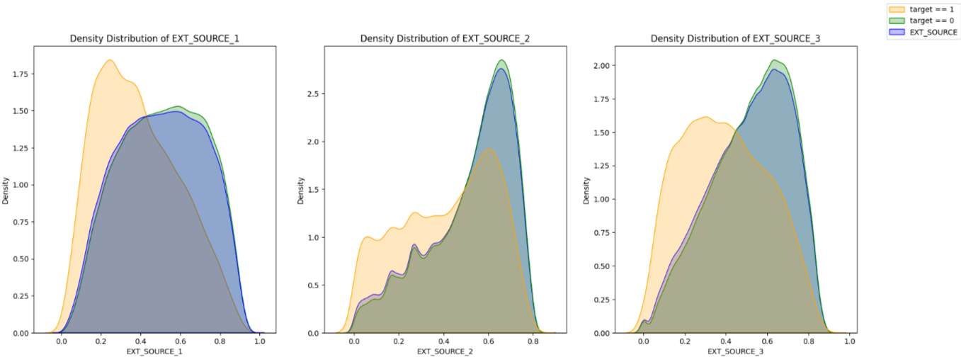
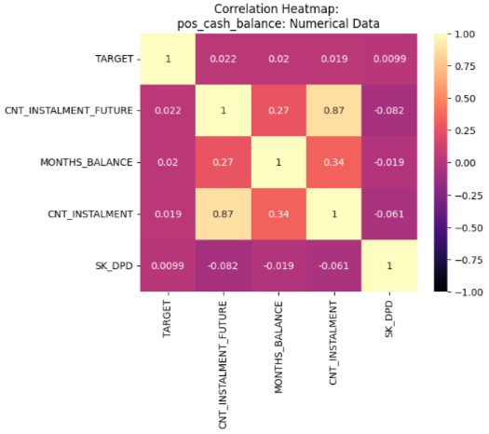
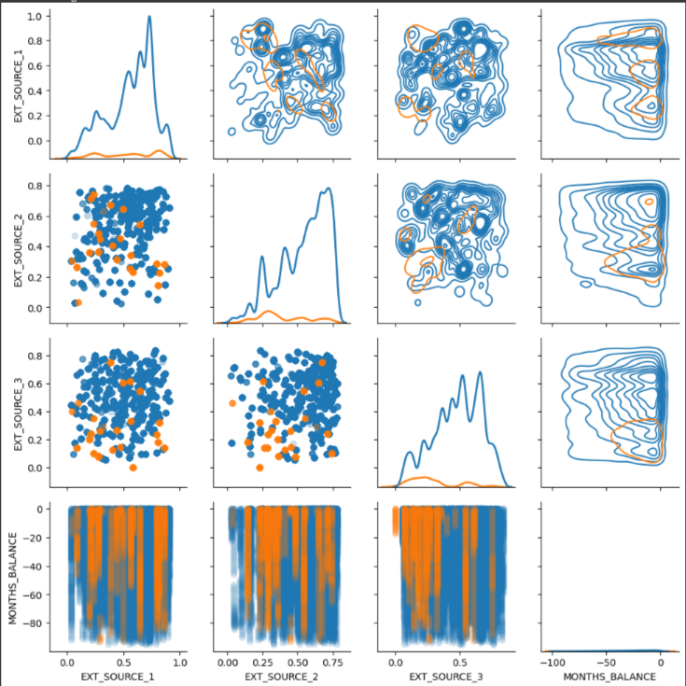
Summary Visual EDA
The use of Kernel Distribution Estimation was extremely helpful when examining separation of target distributions
Heatmaps were essential in understanding correlations and feature selection

Slide 5
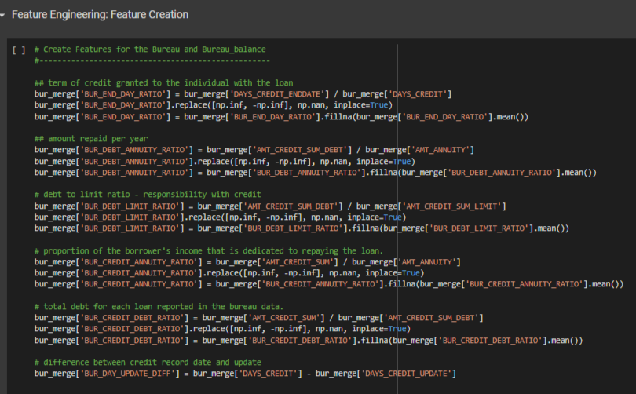
Feature Engineering
Process of feature Engineering
Take the secondary table
Build new features for the data
Run Correlation Analysis on the new table including the new features
Select the features with a correlation above the specified threshold
Merge this new highly correlated table to the main train set
We chose this method since correlation to the target seems to be an accurate predictor of data significance

Slide 6
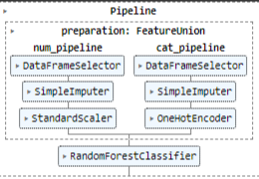
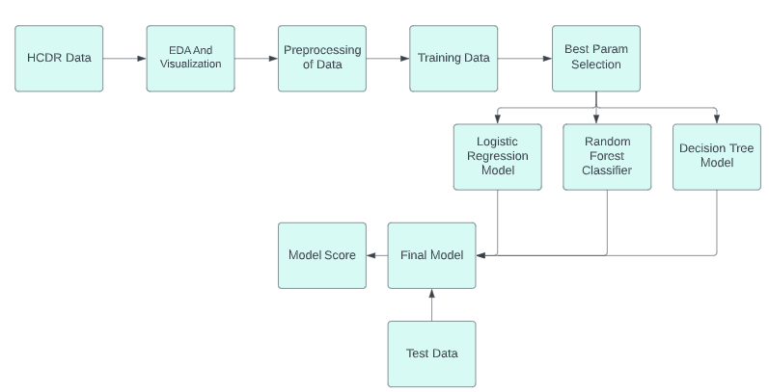
ML Pipeline

Slide 7
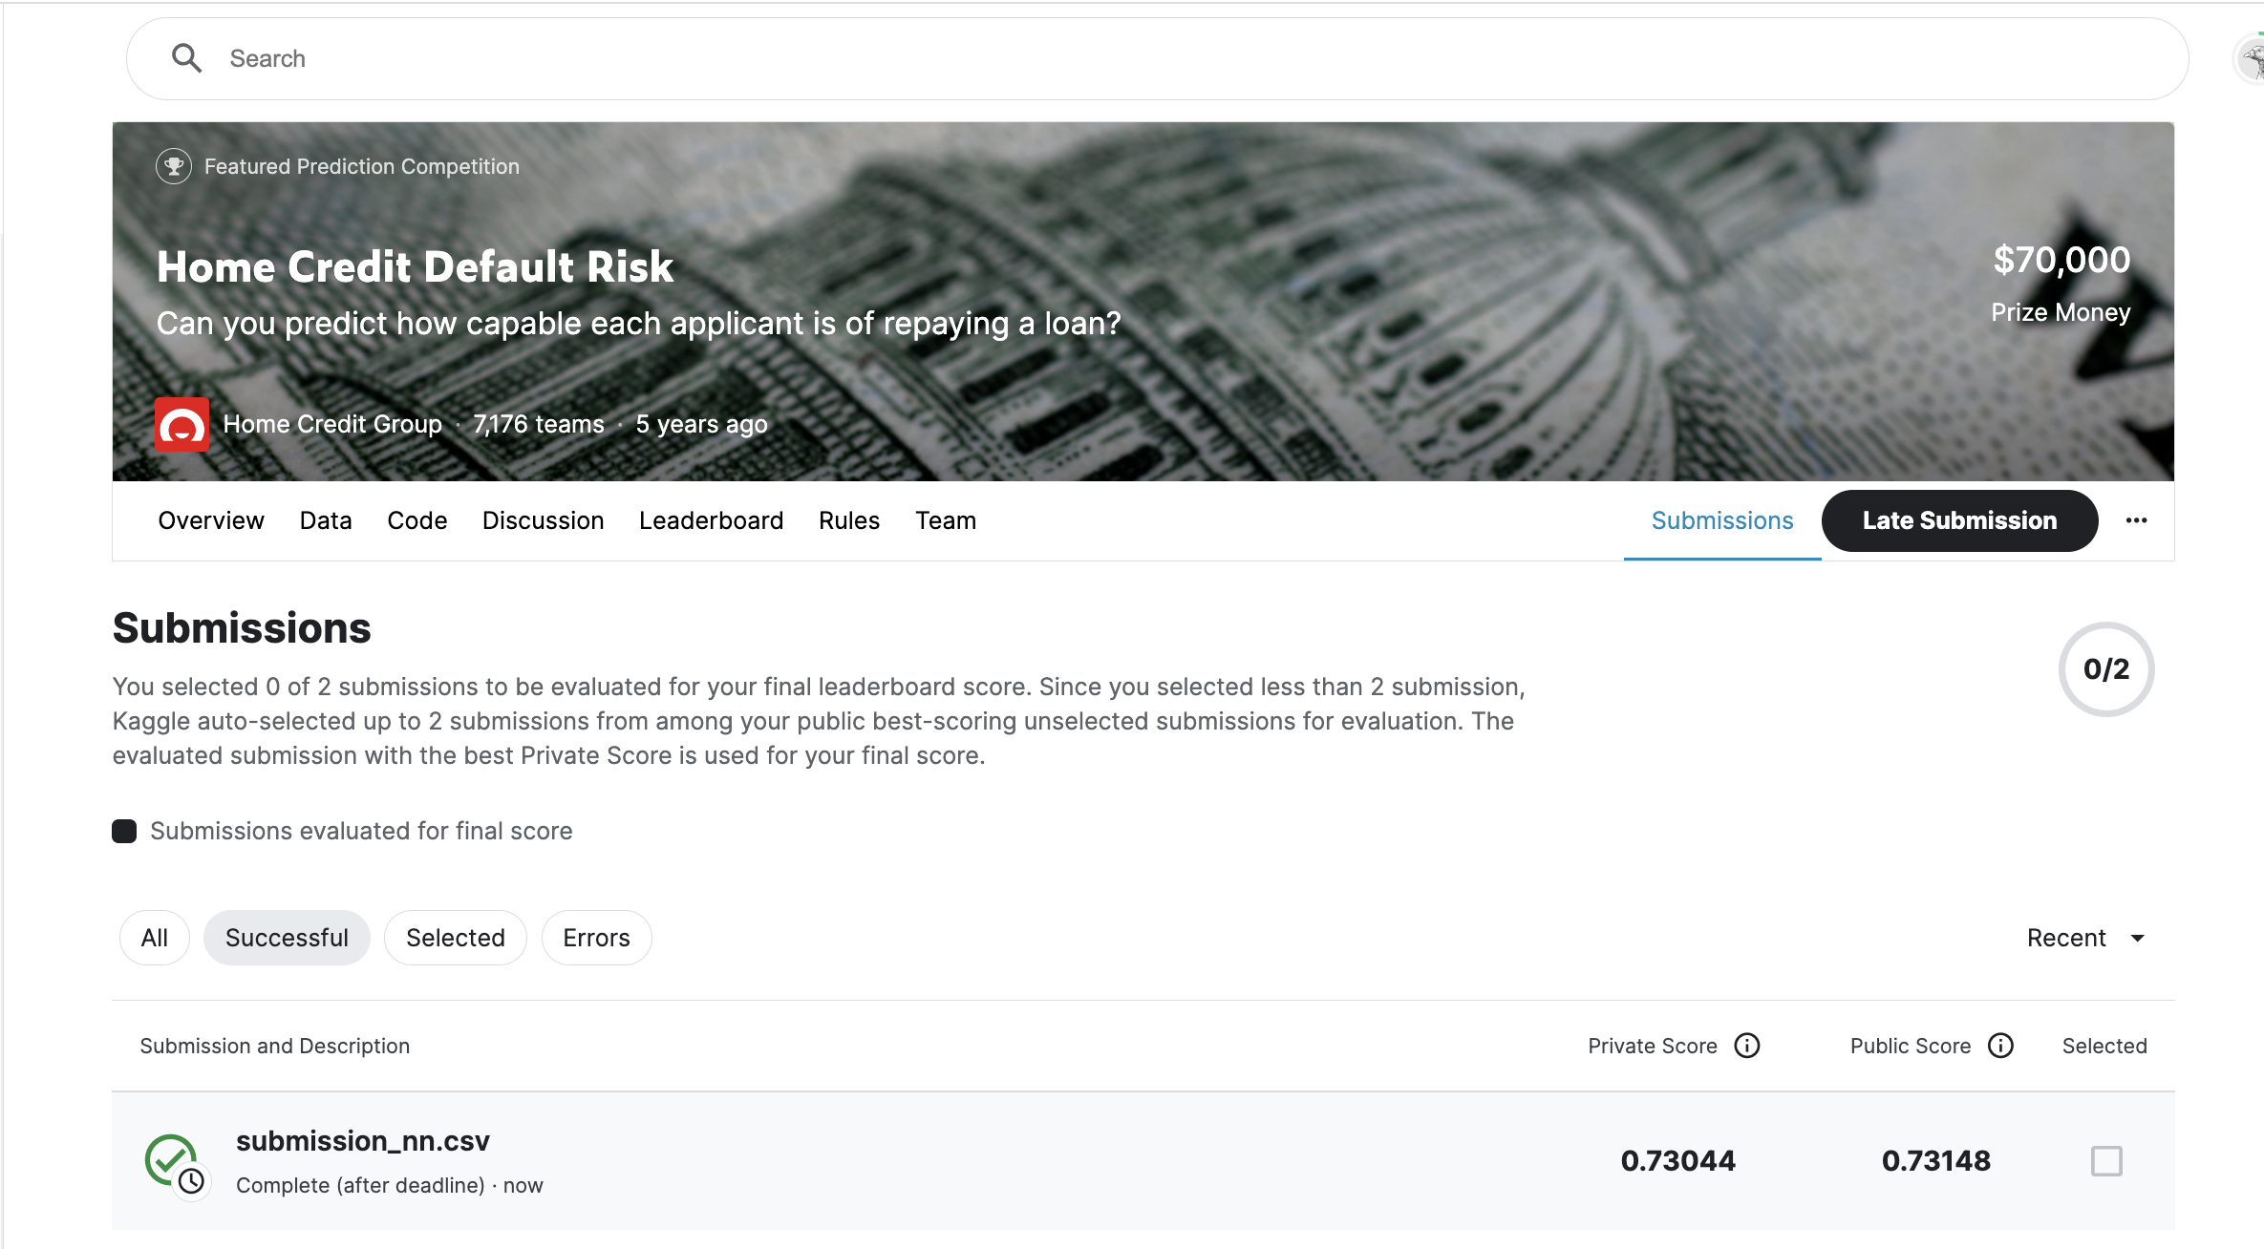
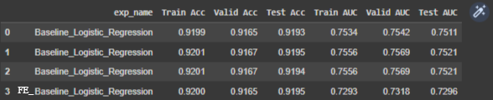
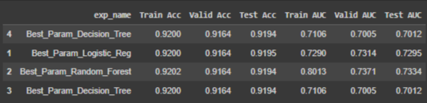
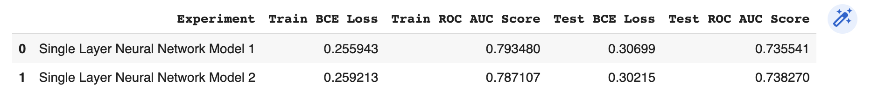
Results and discussion of results
We can see that as we trained our data on the newly created features the AUC dropped, mainly because of a reduction of features
However we have found that Random Forest Classifier Performs the best on this set

Slide 8
4Ps: Past, Present, Planned, Problems
Past: Context of the Project
The HCDR Project aims to predict if customers of Home Credit are able to repay a loan without a recorded credit score or agreed upon metric.
Present: What we have done
Implemented Neural Network Model using Pytorch for loan default classification.
Planned:
We will try to improve the accuracy and AUC score of model using Deep learning.
Problems:
Final training on the larger dataset with additional features.

Slide 9
Conclusion and next steps
In this last phase we implemented a NN model using Pytorch for loan default classification.
Deep Learning models require huge amount of data to train itself and thus on a longer run Deep Learning models would work best for HCDR classification as compared to usual supervised models.
The future scope for this project can include using embeddings in deep learning models or using some advanced classification models like lightGBM/other boosting models that can produce better results.
In our next phase, we will be implementing a deep learning model using PyTorch for classification and regression and also build a multi-headed load default system.

